Slide 1
Advanced Classification Library for ArcGIS
Alpha Version
Adam Wehmann
Autumn 2012
12/4/2012

Slide 2
Introduction
Esri provides only one supervised classification tool for use in ArcGIS.
Maximum Likelihood Classification (MLC) is available through the Multivariate toolbox in the Spatial Analysis extension.
The classification toolset in ArcGIS is inadequate compared to the current state of image classification technology.

Slide 3
Objective
Enhance ArcGIS’s classification abilities by incorporating the ability to perform supervised classification by:
Support Vector Machines (SVM)
Spatial-Temporal Modeling Method (STM)
Liu and Cai 2012
Provide this ability by creating a classification toolbox.
via Python (NumPy, ArcPy) and ModelBuilder.

Slide 4
Support Vector Machines
Background: SVM are a state-of-the art supervised classifier that can consistently deliver superior classification accuracies for remote sensing imagery (Huang 2002, Foody 2004).
Idea: SVM are kernel machines that fit a maximum-margin hyperplane to the data in a higher dimensional space.
Objective: Interface LIBSVM with ArcGIS.
LIBSVM is a popular, freely available SVM classification library written in C++ with Python bindings specifically designed to enhance SVM usage among scientific disciplines.

Slide 5
Spatial-Temporal Modeling Method
Background: STM is a contextual classification method proposed by Dr. Liu and Shanshan Cai of our department that aims to improve multitemporal classification result.
Idea: from a maximum a posteriori Markov Random Field (MAP-MRF) framework, iteratively update classification labels through the minimization of an energy function incorporating spatial and temporal information.
Although stretching the definition, you might visualize this procedure as a 3D cellular automata utilizing a complex, stochastic decision rule where cells can take one of multiple states.
Objective: Develop and interface classifier.

Slide 6
STM Energy Function
Assign a pixel p the label L that minimizes the energy U:
$\underset{L}{arg min}\left\{U\left(L_{p}|{\underline{L}}_{N\left(p\right)}\right)\right\}$
$$\text{where} U\left(L_{p}|{\underline{L}}_{N\left(p\right)}\right) = U_{X}\left(x_{p}|L_{p}\right)+U_{S}\left(L_{p}|{\underline{L}}_{N_{S}\left(p\right)}\right)+U_{T_{1}}\left(L_{p}|{\underline{L}}_{N_{T_{1}}\left(p\right)}\right)+U_{T_{2}}\left(L_{p}|{\underline{L}}_{N_{T_{2}}\left(p\right)}\right)$$
$$=$$
$${−β}_{0}\ln\left(\hat{P}\left(x_{p}|L_{p}\right)\right)$$
$$−β_{1}\sum_{N_{S}\left(p\right)}{I\left(L_{p}=L_{n\left(p\right)}\right)}$$
$$−β_{2}\sum_{N_{T_{1}}\left(p\right)}{P\left(L_{p}|L_{n\left(p\right)}\right)}+β_{3}\sum_{N_{T_{1}}\left(p\right)}{I\left(L_{n\left(p\right)}⇏L_{p}\right)}$$
$$−β_{4}\sum_{N_{T_{2}}\left(p\right)}{P\left(L_{n\left(p\right)}|L_{p}\right)}+β_{5}\sum_{N_{T_{2}}\left(p\right)}{I\left(L_{p}⇏L_{n\left(p\right)}\right)}$$
$$U_{X}$$ | spectral energy | $$β_{i}$$ | weight | $$\hat{P}\left(…\right)$$ | prior probability
$$U_{S}$$ | spatial energy | $$L$$ | class label | $$P(…)$$ | probability
$$U_{T_{1}}$$ | past temporal energy | $$p$$ | pixel | $$I\left(L_{p}={\tilde{L}}_{p}\right)$$ | equality indicator function
$$U_{T_{2}}$$ | future temporal energy | $$N\left(p\right)$$ | neighborhood of a pixel | $$I\left(L_{p}⇏{\tilde{L}}_{p}\right)$$ | exclusion indicator function

Slide 7
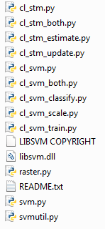
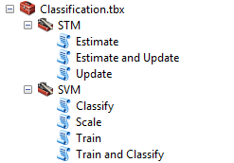
Results
Project Size
1 toolbox
7 tools
10 scripts
1045 lines of code

Slide 8
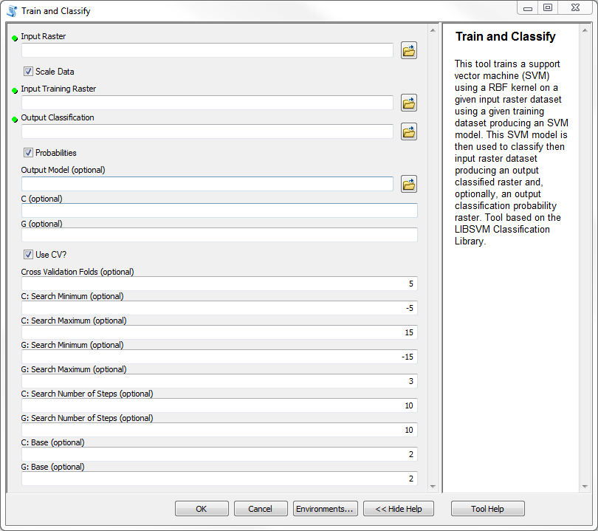

Slide 9
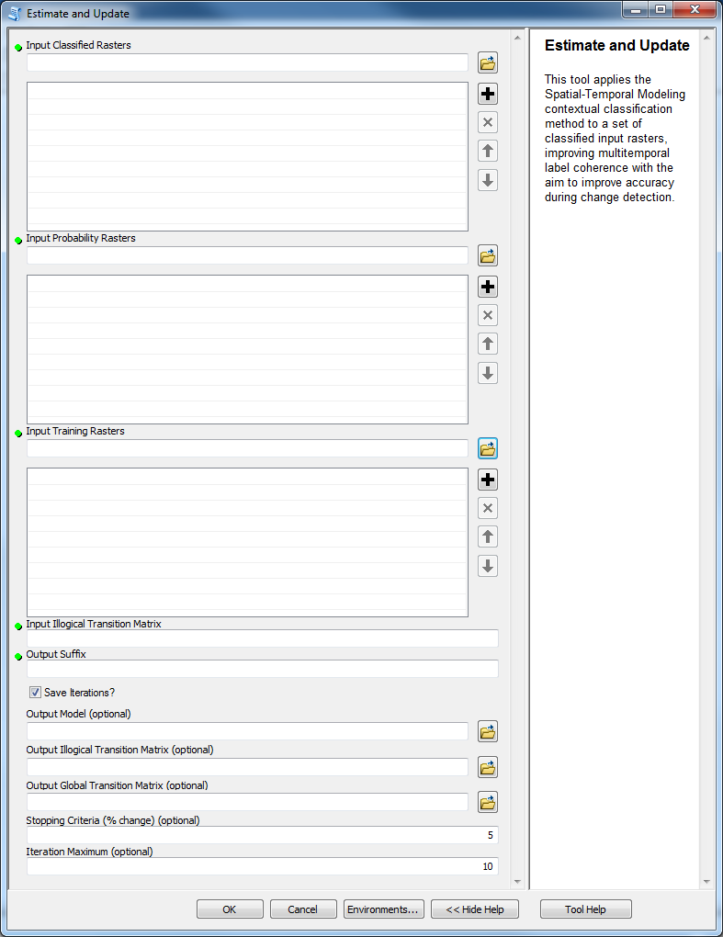

Slide 10
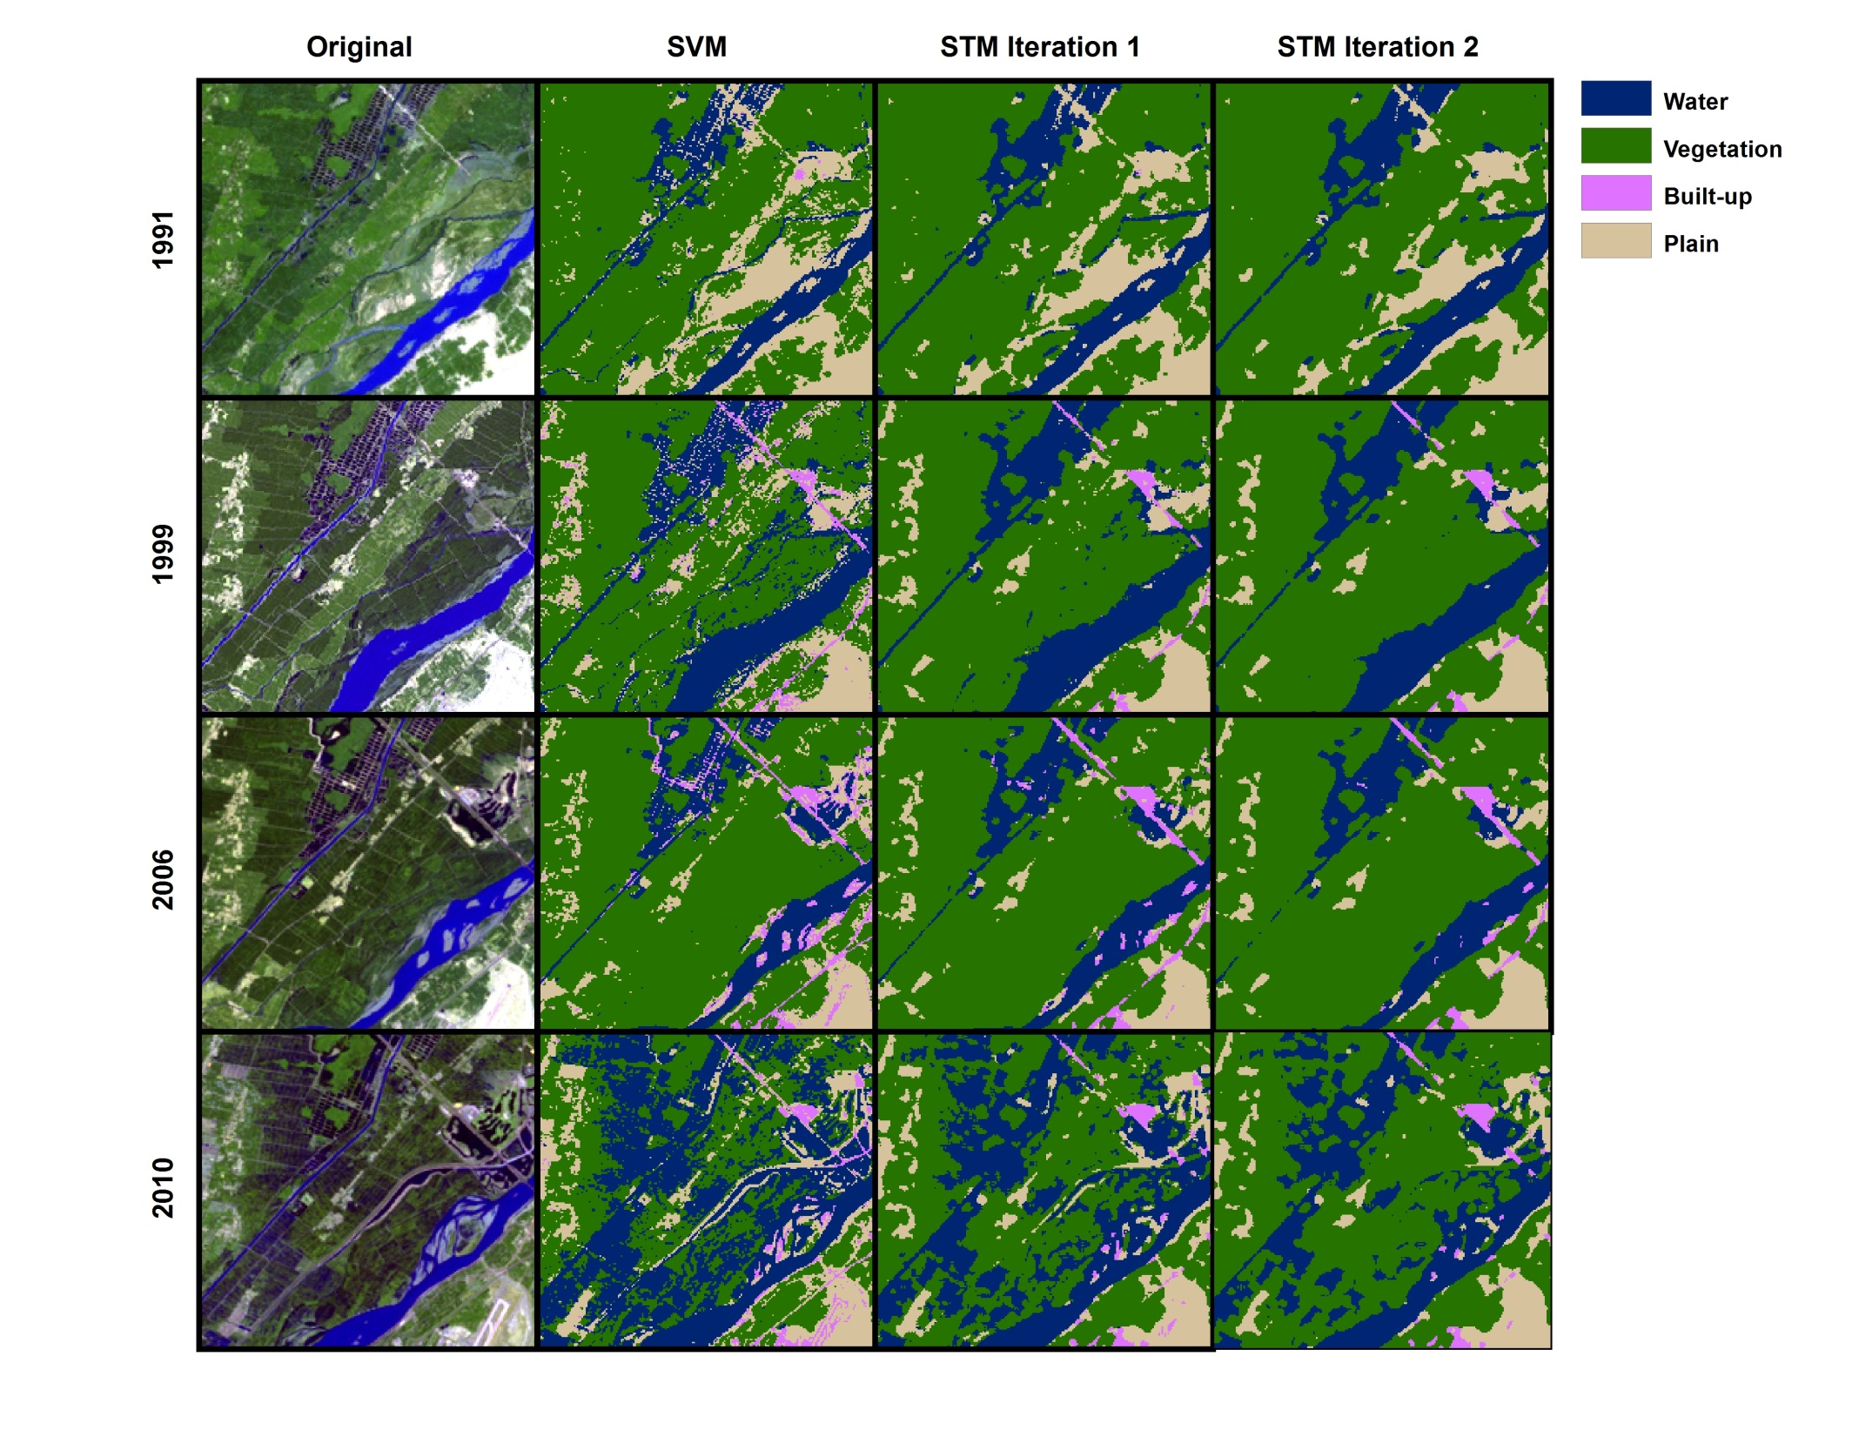
Notes:
Subset of scene of Yinchuan, Ningxia, China: 1991, 1999, 2006, 2010 – not great training data here (and for much larger area)

Slide 11
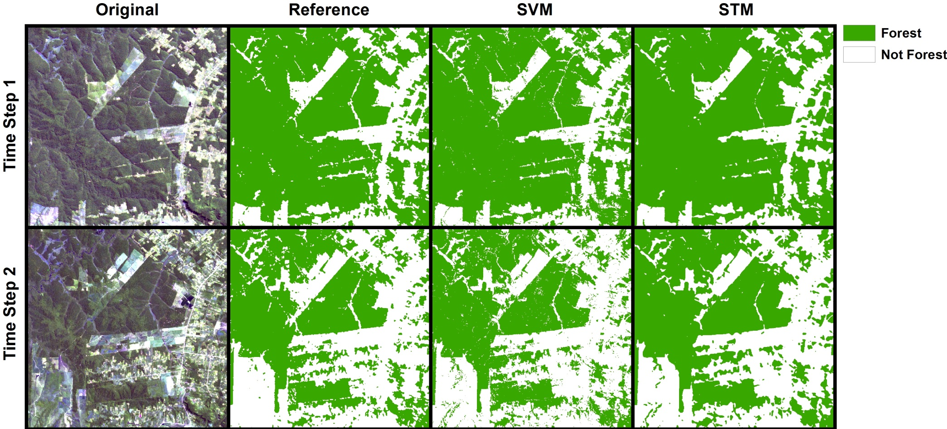
Data: Liu 2008 (provided by Shanshan Cai)
Notes:
Paraguay, 1990 and 2001, cf. Liu 2008

Slide 12
Future
More testing is needed prior to public release.
Obtaining and producing better testing data will be part of this.
Production of stand-alone scripts using GDAL to load data instead of ArcPy functions.
Further documentation.

Slide 13
References
Allen, D.W. 2011. Getting to Know ArcGIS ModelBuilder. ESRI Press.
Chang, C-C. and C-J. Lin. 2011. LIBSVM: a library for support vector machines, ACM Transactions on Intelligent Systems and Technology, 2(27), pp. 1-27. Software available at: http://www.csie.ntu.edu.tw/~cjlin/libsvm
Foody, G.M and A. Mathur. 2004. A relative evaluation of multiclass image classification by support vector machines. IEEE Transactions on Geoscience and Remote Sensing, 42(6), pp. 1335-1343.
Huang, C., L.S. Davis, and J.R.G. Townshend. 2002. An assessment of support vector machines for land cover classification. International Journal of Remote Sensing, 23(4), pp. 725-749.
Liu, D., M. Kelly, and P. Gong. 2006. A spatial-temporal approach to monitoring forest disease spread using multi-temporal high spatial resolution imagery. Remote Sensing of the Environment, 101, pp. 167-180.
Liu, D., K. Song, J.R.G. Townshend, and P. Gong. 2008. Using local transition probability models in Markov random fields for forest change detection. Remote Sensing of the Environment, 112, pp. 2222-2231.
Liu, D. and S. Cai. 2012. A spatial-temporal modeling approach to reconstructing land-cover change trajectories from multi-temporal satellite imagery, Annals of the Association of American Geographers, 102(6), pp. 1329-1347.
Melgani, F. and S.B. Serpico. 2003. A Markov random field approach to spatio-temporal contextual image classification. IEEE Transactions on Geoscience and Remote Sensing, 41(11), pp. 2478-2487.
Tso, B. and P.M. Mather. 2009. Classification Methods for Remotely Sensed Data. Boca Raton: CRC Press.

