Slide 1
A Spatial-Temporal Contextual Kernel Method for Generating High-Quality Land-Cover Time Series
Department of Geography
The Ohio State University
Email: wehmann.2@osu.edu
Adam Wehmann
Thesis Defense Presentation
23 April 2014

Slide 2
Outline
Introduction
Background
Methods
Results
Discussion
Conclusion

Slide 3
Introduction

Slide 4
Multi-Temporal Land-Cover Mapping
Allows us to detect, monitor, and quantify land-cover change.
Through examination of
differences between two dates
or trajectories of change over time
However, the accuracy and consistency of land-cover time series is paramount!

Slide 5
Multi-Temporal Accuracy
See also: van Oort, 2005; Burnicki et al., 2007; Liu and Chun, 2009; Liu and Cai, 2012
Uncorrelated error structure:
Product of individual date accuracies
Correlated error structure:
Minimum of individual date accuracies
Partially correlated error structure:
Average of the above two measures
Number of Image Dates
Overall Accuracy at Individual Dates
Average Overall Accuracy of Trajectories

Slide 6
Spatial-Temporal Consistency
Uncorrelated Error Structure
Correlated Error Structure
Errors at Time 1
Errors at Time 2
Errors at Time 1
Errors at Time 2
OA 75%
OA 75%
OA 75%
OA 75%
Multi-Temporal Error Structure
Multi-Temporal Error Structure
OA 54%
OA 71%

Slide 7
Problem of Change Detection Reliability
Without both high accuracy at individual dates and spatial-temporal consistency, reliable change detection is impossible!
GLC2000
Ironically, we will not be able to identify change areas comparing existing 1992/1993 data and 2000/2001 data, simply because the “variability between estimates substantially exceeds that of actual land cover changes.”
Giri, Zhu, & Reed (2005)
GLCC, GLC2000, MODIS
There is common agreement within the land cover mapping community that the accuracies of individual land cover products are insufficient to detect land cover change reliably.
Jung et al. (2006)
MODIS
The present capability in producing accurate land cover maps over large areas is far from satisfactory.
Liang & Gong (2010)

Slide 8
Solution and Objective of Thesis
Contextual classification offers ability to make better use of geographic information, yet variously:
Existing methods can better use contextual information.
Existing methods lack integration of classifiers.
Existing methods are not resistant to sensor advancement.
Objective: Advance methodology for multi-temporal land-cover mapping through the development of contextual classifier that:
Improves classification accuracy over the state-of-the-art.
Increases spatial-temporal consistency among land-cover maps.
Remains robust against advances in remote sensor technology.

Slide 9
Background

Slide 10
Classification
Automatically categorize measurements into informative land-cover classes.
In remote sensing, the Support Vector Machine is a leading non-contextual technique.
See also: Huang et al., 2002; Foody and Mathur, 2004
Image Source: Wikimedia Commons

Slide 11
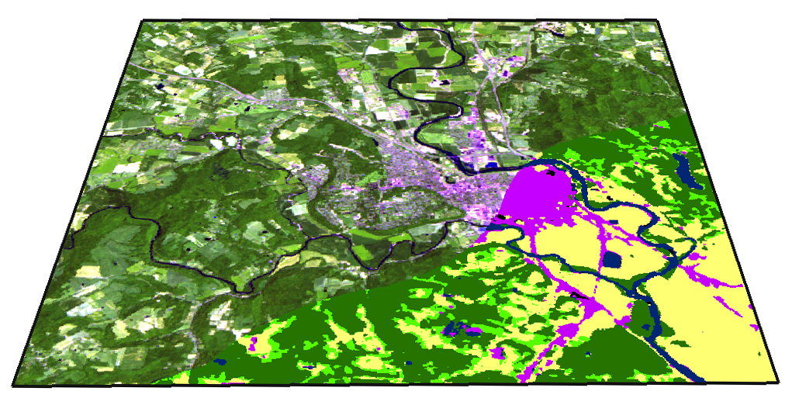
Contextual Classification
Use site-specific information to make classification decisions.
Aids in discrimination under:
high within-class spectral variability
low between-class spectral variability
mismatch between thematic and spatial resolutions
July 17, 2008 -- Chillicothe, Ohio (Ross County)

Slide 12
Literature
Object-Based Image Analysis
calculate textural, topological, and shape-based measures for image objects for use in classification
typically performed with significant human interaction through specification of ad hoc rules
unclear methodology to generalize to temporal domain
Markov Random Field Models
statistically model contextual relationships within image structure as prior information
e.g. pixel-level, object-level, multi-scale
automatable, flexible, and adaptive
highly dependent on initial non-contextual classification results
Contextual Kernel Methods
exploit similarity of data in a transformed feature space
flexible incorporation of domain knowledge and prior information to learn general relationships in data
typically simple combinations of local statistical information as context from remote sensing data

Slide 13
Methods

Slide 14
Kernel Method
“A complex pattern-classification problem, cast in a high-dimensional space nonlinearly, is more likely to be linearly separable than in a low-dimensional space, provided that the space is not densely populated.”
Cover, T. M., Geometrical and statistical properties of systems of linear inequalities with applications in pattern recognition, 1965
Image Source: Wikimedia Commons

Slide 15
Markovian Kernel
Given the energy function for the Markov Random Field model used in Liu and Cai (2012):
label at pixel i
$$U_{i}\left(y_{i} | x_{i},{\left\{y_{∂_{k}\left(i\right)}\right\}}_{k}\right)=−\ln{p\left(x_{i} | y_{i}\right)}+\sum_{k=1}^{κ}{β_{k}ℰ_{i,k}\left(y_{i} | y_{∂_{k}\left(i\right)}\right)}$$
 | $ℇ_{i,1}\left(y_{i} | y_{∂_{1}\left(i\right)}\right)=−\sum_{j∈∂_{1}\left(i\right)}{I\left(y_{i}=y_{j}\right)}$ | spatial energy
 | $ℇ_{i,2}\left(y_{i} | y_{∂_{2}\left(i\right)}\right)=−\sum_{j∈∂_{2}\left(i\right)}{p\left(y_{i} | y_{j}\right)}$ | past temporal energy
 | $ℇ_{i,3}\left(y_{i} | y_{∂_{3}\left(i\right)}\right)=−\sum_{j∈∂_{3}\left(i\right)}{p\left(y_{j} | y_{i}\right)}$ | future temporal energy
 | $ℇ_{i,4}\left(y_{i} | y_{∂_{4}\left(i\right)}\right)= \sum_{j∈∂_{4}\left(i\right)}{I\left(y_{j}⇏y_{i}\right)}$ | past temporal penalty
 | $ℇ_{i,5}\left(y_{i} | y_{∂_{5}\left(i\right)}\right)= \sum_{j∈∂_{5}\left(i\right)}{I\left(y_{i}⇏y_{j}\right)}$ | future temporal penalty
spectral data at pixel i
labels at neighbors to pixel i
likelihood
weight
prior information
contextual information

Slide 16
Markovian Kernel
Decision rule can be equivalently expressed as a kernel expansion involving:
$$K_{STP}\left(x_{i},{\left\{ε_{i,k}\right\}}_{k};x_{j},{\left\{ε_{j,k}\right\}}_{k}\right)=K\left(x_{i},x_{j}\right)+\sum_{k=1}^{κ}{ρ_{k}ε_{i,k}ε_{j,k}}$$
where $ρ$ are weights to be learned and:
$$ε_{i,k}=ℰ_{i,k}\left(−1 | y_{∂_{k}\left(i\right)}\right)−ℰ_{i,k}\left(1 | y_{∂_{k}\left(i\right)}\right)$$
$k\left(x_{i},x_{j}\right)=\text{exp}\left(−γ{\left\|x_{i}−x_{j}\right\|}^{2}\right)$ where $γ>0$
Generalization of method of Moser and Serpico (2013).
spectral data
base kernel
weight
contextual feature
bandwidth

Slide 17
Proposed Classifier
Reformulating as kernel:
integrates Support Vector Machine with Markov Random Field
allows non-linear and margin-maximized decisions to be made about contextual information
allows arbitrary input data dimensionality
creates sparsely supported decision surfaces
Use in a Spatial-Temporal Markovian Support Vector Classifier:
iterative
hierarchical
i.e. ST HMSVC

Slide 18
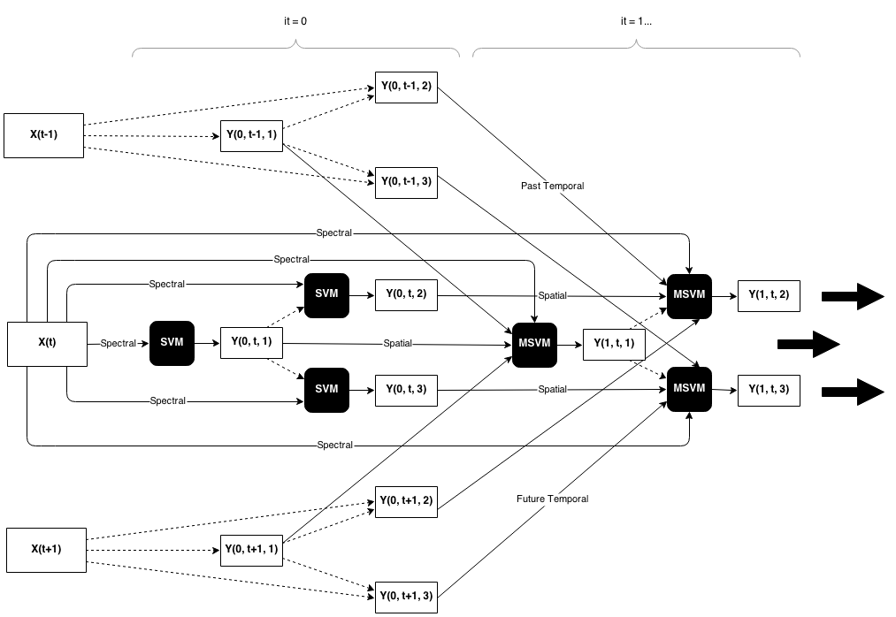
Spatial-Temporal Hierarchical Markovian Support Vector Classifier
Note: Y(iteration, time, subproblem)
Notes:
computationally burdensome, but also parallelizable

Slide 19
Results

Slide 20
Appalachian Ohio Case Study
Ross County, Ohio
dominated by agricultural use
less forest coverage than surrounding counties
some mining activities and urban expansion
Time Period
1988 – 2008 in five year intervals
summer acquisition dates
Sensor
Landsat-5 TM
30 m ground resolution
Data courtesy of Liu and Cai 2012
Illogical Transitions:
 | To
From | Water | Forest | Crop | Urban | Mine | Grass / Shrub
W |  | X |  |  | X
F
C |  | X
U | X | X | X |  | X
M |  | X |  | X
G
The symbol X indicates the transition is illogical.

Slide 21
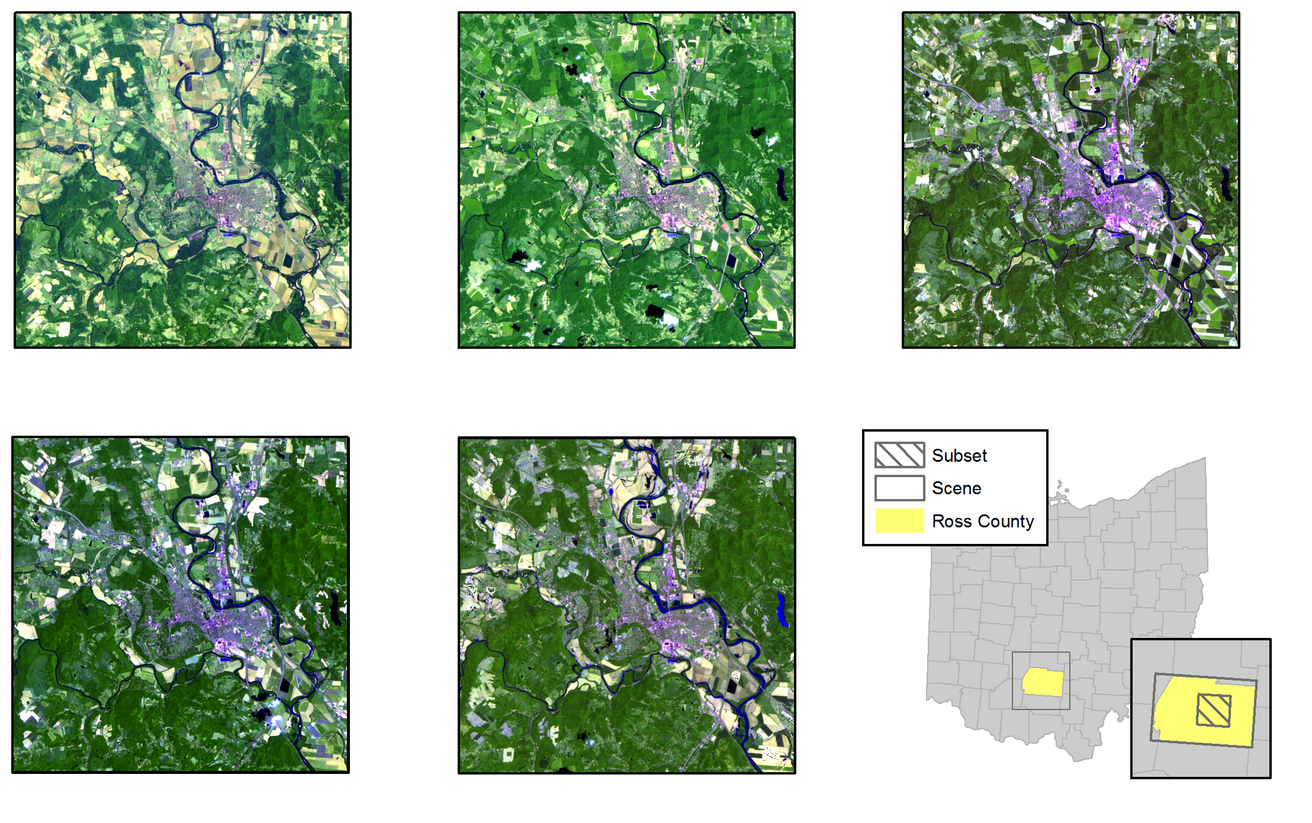
1988
1993
1988
2003
2008

Slide 22
Results: Accuracy
*
*
*
*
*
*
*
*
*
*
*
*
*
*ed items are significant at the α = 0.05 level by the two kappa comparison test

Slide 23
Results: Temporal Consistency

Slide 24
Results: Spatial Consistency
SVM: Classification at 2003
ST HMSVC: Classification at 2003

Slide 25
Results: Spatial-Temporal Consistency
SVM: Transition Counts at 2003
ST HMSVC: Transition Counts at 2003

Slide 26
Results: Spatial-Temporal Consistency
SVM: Illogical Transitions at 2003
ST HMSVC: Illogical Transitions at 2003

Slide 27
Results: Land Cover Area

Slide 28
Discussion and Conclusion

Slide 29
Conclusion
Substantial improvements in all standard metrics:
Increase in accuracy of change detection (+14.07% over SVM, +7.99% over MRF)
Increase in accuracy at individual dates (+6.75% over SVM, +3.75% over MRF)
Increase in average accuracy at individual dates (not presented)
Decrease in frequency of illogical land-cover transitions (-14.36% over SVM, -3.85% over MRF)
Decrease in number of trajectories undergoing illogical change (-13.65% over SVM, -3.94% over MRF)
Decrease in number of trajectories undergoing change (-22.26% over SVM, -8.3% over MRF)
Limitations:
Hierarchical classification requires same classification tree be used for each image date.
Computationally intensive, but not intractable.
~ 15 minutes for 1500 x 2000 pixels at 5 image dates for 10 iterations with 6 land cover classes
Exceeds competitive techniques in multi-temporal land-cover mapping.

Slide 30
Future Work
Publication.
NESSF Proposal:
A Spatial-Temporal Structured Learning Framework for Reconstructing Land-Cover Change Trajectories from Dense Landsat Time Series
Continue on with Ph.D. here at OSU under Dr. Desheng Liu.

Slide 31
References
Burnicki, A. C., Brown, D. G., & Goovaerts, P. (2007). Simulating error propagation in land-cover change analysis: The implications of temporal dependence. Computers, Environment and Urban Systems, 31(3), 282-302.
Cover, T. M. (1965). Geometrical and statistical properties of systems of linear inequalities with applications in pattern recognition. IEEE Transactions on Electronic Computers, EC-14, 326-334.
Foody, G. M., & Mathur, A. (2004). A relative evaluation of multiclass image classification by support vector machines. IEEE Transactions on Geoscience and Remote Sensing, 42(6), 1335-1343.
Giri, C., Zhu, Z., & Reed, B. (2005). A comparative analysis of the Global Land Cover 2000 and MODIS land cover data sets. Remote Sensing of Environment, 94, 123-132.
Huang, C., Davis, L. S., & Townshend, J. R. G. (2002). An assessment of support vector machines for land cover classification. International Journal of Remote Sensing, 23(4), 725-749.
Jung, M., Henkel, K., Herold, M., & Churkina, G. (2006). Exploiting synergies of global land cover products for carbon cycle monitoring. Remote Sensing of Environment, 101, 534-553.
Liang, L. & Gong, P. (2010). An assessment of MODIS Collection 5 global land cover product for biological conservation studies. 2010 18th International Conference on Geoinformatics, 18-20 June, 1-6.
Liu, D., & Chun, Y. W. (2009). The effects of different classification models on error propagation in land cover change detection. International Journal of Remote Sensing, 30(20), 5345-5364.
Liu, D., & Cai, S. (2012). A spatial-temporal modeling approach to reconstructing land-cover change trajectories from multi-temporal satellite imagery. Annals of the Association of American Geographers, 102(6), 1329-1347.
Moser, G. & Serpico, S. B. (2013). Combining support vector machines and Markov random fields in an integrated framework for contextual image classification. IEEE Transactions on Geoscience and Remote Sensing, 51(5), 2734-2752.
van Oort, P. J. (2005). Improving land cover change estimates by accounting for classification errors. International Journal of Remote Sensing, 26(14), 3009-3024.

Slide 32
Thank you.
wehmann.2@osu.edu

